Slide 1

Email Management System
Presented by
Rahul.S
Under the guidance of
Mrs.Pavithra

Slide 2
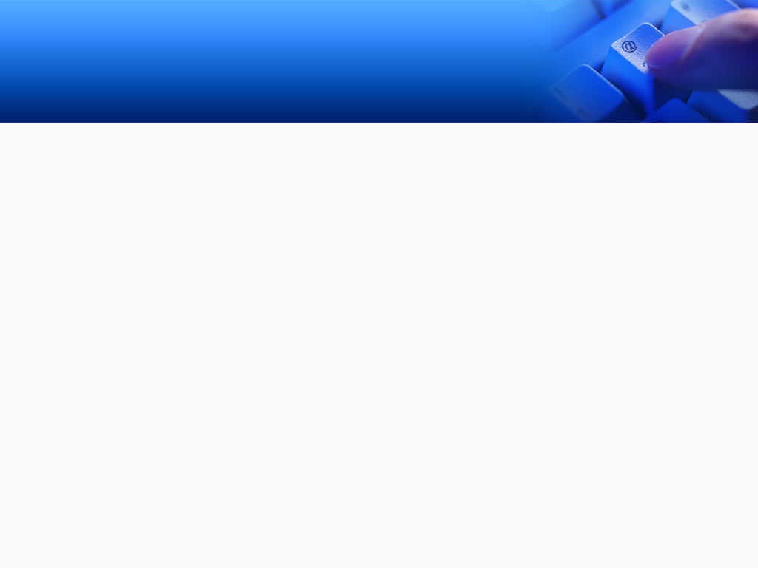
INTRODUCTION
Do you ever feel like the only person who doesn't use email? You don't have to feel left out. If you're just getting started, you'll see that with a little bit of practice, email is easy to understand and use.
What email is, how it compares to traditional mail, and how email addresses are written. We'll also discuss various types of email providers and the features and tools they include with an email account.
One of the main objectives of an email marketing campaign is to inform your readers.
Another objective of email marketing is to attract users to the company.

Slide 3
WHAT IS EMAIL MANAGEMENT ?
As the de facts standard for business communication , removing emails from the server and saving them to a repository is not enough.
Email must be clarified,stored,and destroyed constistent with business standards-just as with any other document or record.

Slide 4
WHY ARE WE SENDING EMAIL SO MUCH ?
It is easy
It is nearly instantaneous
It is asynchronous
It is convenient
It is platform neutral
There is a written record of communication

Slide 5
Why is email management ?
Email is different from other information types
1.Volume
2.Informality
3.Ease of creation and forwarding
4.Attachments
5.Metadata
Email requires different tactics

Slide 6
Email management is not
Saving all messages forever
Saving all email messages in the messaging application
Setting arbitrary time limits for all messages
Setting arbitrary mail box sizes for all users
Declaring “email” as a record series
Doing nothing

Slide 7
Requirements Specification
Software Requirements
Core Java
OS 1.1, 1.5, 1.6, 2.0
Eclipse
Hardware Requirements
Processor : Pentium IV 1Ghz
Hard disk : 80GB
RAM : 1GB

Slide 8
DESIGN

Slide 9
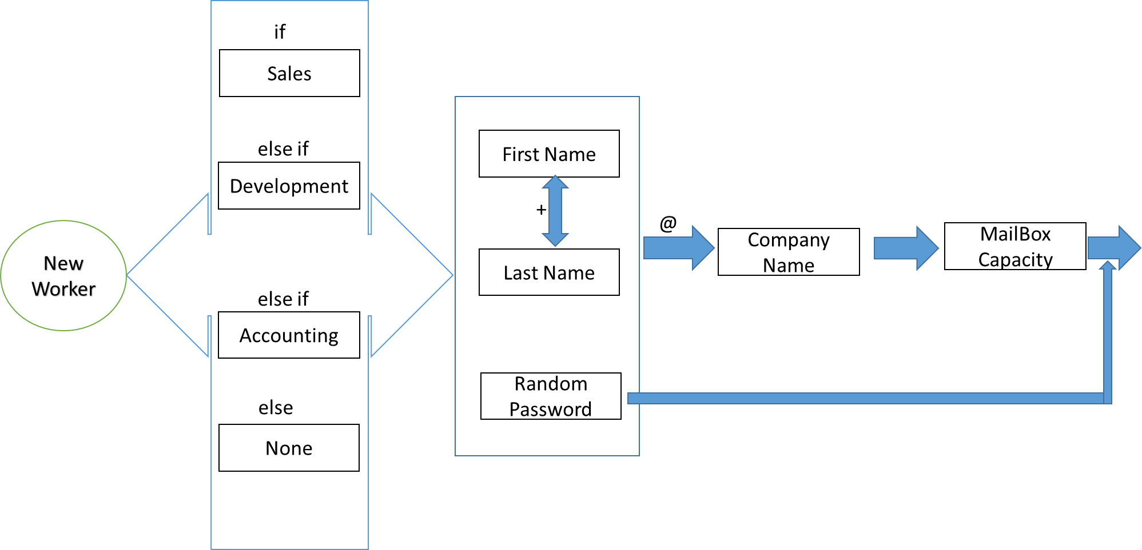
USECASE DIAGRAM

Slide 10
MODULES

Slide 11
EMAIL CLASS
EMAIL MAIN CLASS

Slide 12
Effective usage
Provides guidance on drafting messages
Wording and punctuation
Spell and grammer check
Effective subject lines
Provides guidance on small etiquette
May also provide guidance on addresses

Slide 13
Email policy statements
Every organization’s email policy will be different
1.Private vs public sector
2.Regulatory requirements , both horizontal and vertical
There are some common areas that should be addressed.

Slide 14
Security
Attachment limitations
Wheather they can sent at all
Size limitations
Format or content type limitations
Non-business-related attachments
Attachment vs links
Content filtering
Encryption and DRM

Slide 15
OVERVIEW OF TECHNOLOGIES USED

Slide 16
About JAVA
About JAVA
It is a simple programming language. Java makes writing, compiling, and debugging programming easy. It helps to create reusable code and modular programs.
Java is a class-based, object-oriented programming language and is designed to have as few implementation dependencies as possible.
A general-purpose programming language made for developers to write once run anywhere that is compiled Java code can run on all platforms that support Java.
Java applications are compiled to byte code that can run on any Java Virtual Machine. The syntax of Java is similar to c/c++.
The principles for creating java were simple, robust, secured, high performance, portable, multi-threaded, interpreted, dynamic, etc.
In 1995 Java was developed by James Gosling, who is known as the Father of Java. Currently, Java is used in mobile devices, internet programming, games, e-business, etc.
On November 13, 2006, Sun released much of its Java virtual machine as free, open-source software. On May 8, 2007, Sun finished the process, making all of its JVM’s core code available under open-source distribution terms.

Slide 17
About ECLIPSE
Eclipse is an integrated development environment (IDE) that takes care of compiling and running Java programs in addition to providing other useful features such as version control and debugging.
Thus, it is a popular tool for programmers to write and test their code.
Eclipse IDE (integrated development environment) for Java has been the leading development environment with a market share of 65% as of today.
It can be extended with an additional software component. Eclipse calls these software components as plugins, which can grouped into features.
Many companies have extended Eclipse IDE on top of the Eclipse framework. It is also available as IDE for other languages.
Resources are items in the workspace, i.e. projects, folders, files and other dependent resources. These are all objects that will be or have been created with Eclipse. They are stored as normal files within the Eclipse workspace. A project holds several folders with files.

Slide 18
IMPLEMENTATION

Slide 19
INTEGRATION AND TESTING
Integration
Integration is all about combining the individual parts of the system and making the system into a single unit.
Testing
1. Compilation Test: Stress testing is done early on, because it gives us time to fix some of the unexpected stability problems that only occur when components are exposed to very high transaction volumes.
2. Execution Test: The program is successfully loaded and executed with no execution errors. The complete performance of the project “Library Management System” is good.

Slide 20
OUTPUT SCREENS

Slide 21
Conclusion
Because of CMS environment this web service is purely client oriented.
As a learner , it is a good experience for work in real company environment.
With the concept of layering, we can reduce the complexity of the project.
Data abstraction and data reusability essence the power of project.

Slide 22
FUTURE SCOPE

Slide 23
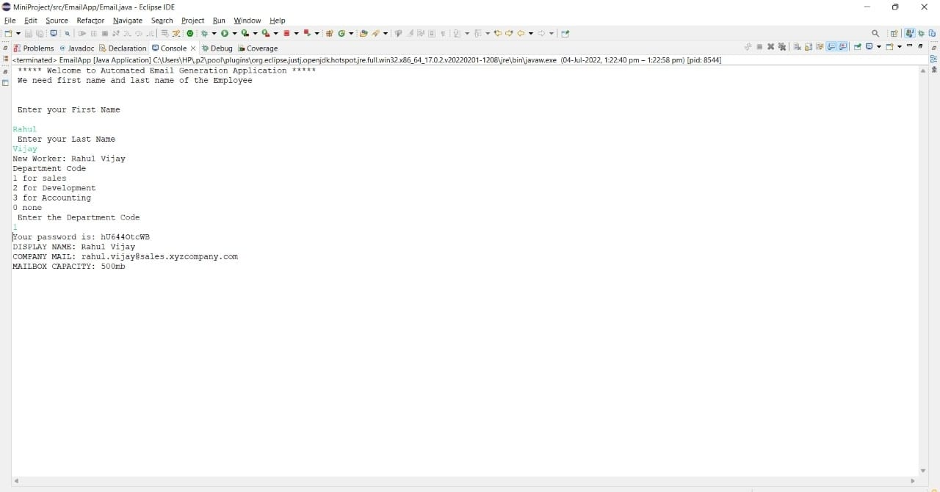

Slide 24
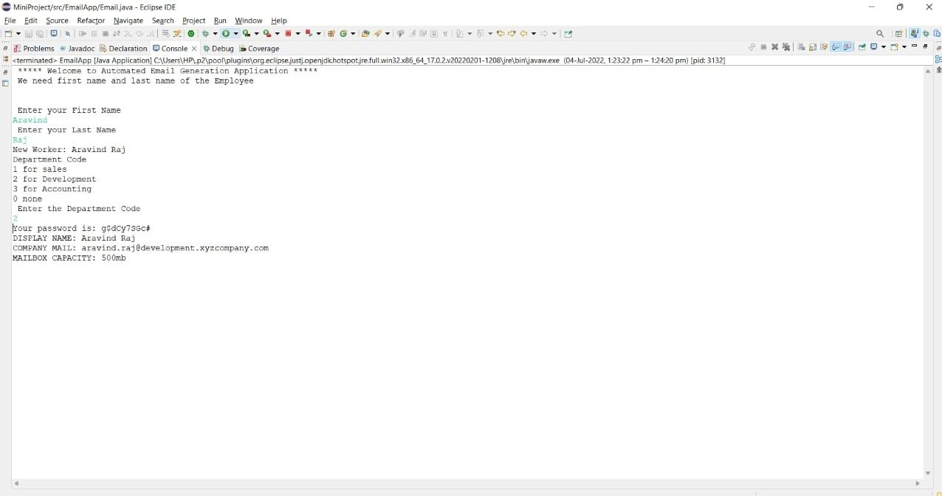

Slide 25
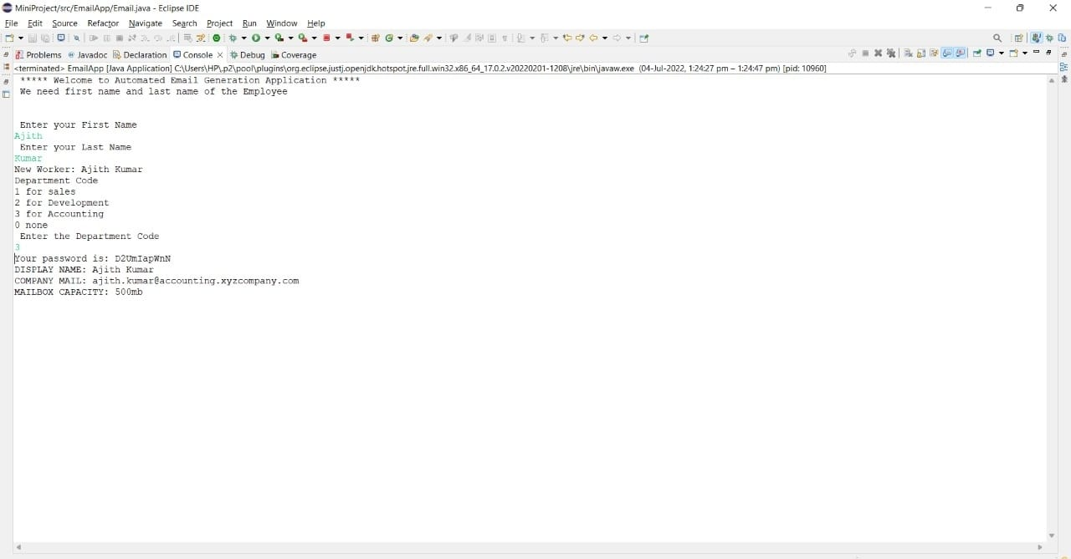

Slide 26
By 2023, there will be an estimated 4.3 billion global email users, according to Statista.
Since most users tend to look at promotional emails in the same light as spam, future email marketing campaigns should aim to be more personalized.
Email marketing methods that make the message work more like a website and that are easily accessible on mobile devices will be important.
This article is for small business owners and marketers looking to prepare for the future of email marketing.
It’s hard to imagine a world without email. More than 4 billion people are expected to have at least one email address by 2023, making email one of the most common forms of communication on the planet.
With such a large user base, it makes sense that marketing teams try to capitalize on that base by sending their messages directly to their intended audience’s inboxes.

Slide 27
REFERENCES

Slide 28
https://www.javapoint.com/how-to-use-eclipse-for java
https://www.javapoint.com/file-operations-in-java
https://www.w3schools.com/java/java inheritance.asp

Slide 29
THANK YOU

